Slide 2
Land Acknowledgement
Aaniin, Boozhoo, Tansi, Wotziye, Ho/Han, Tanshi, Tunngasugitsi!
The DEAM 2020 Webinar is located on Treaty 1 Territory,
the original lands of the Anishinaabeg, Cree, Oji-Cree, Dakota,
& Dene peoples, and the homeland of the Métis Nation.
We encourage you to reflect on the history of the land
that you are watching from.

Slide 3
Webinar Technical Assistance
Call: 204-945-7613
Toll-free: 1-800-282-8069 ext. 7613
Email: dio@gov.mb.ca

Slide 4
Greetings & Opening Remarks
Accessibility Standard for Employment
To ensure the safety of employees with disabilities, all employers in the public, private & non-profit sectors must comply by May 1, 2020 with the following two requirements:
Workplace Emergency Response Information
Workplace Emergency Assistance

Slide 5
Shane Kanady - DEAM Keynote Speaker
VP Workforce Development, SourceAmerica
Senior Fellow, Portulans Institute
Domestic, US topics: skanady@sourceamerica.org
International topics: kanady@portulansinstitute.org
LinkedIn Profile: https://www.linkedin.com/in/shane-kanady-7388bb132/
Notes:
Image credits:
https://www.google.com/url?sa=i&url=https%3A%2F%2Ffr.linkedin.com%2Fcompany%2Fportulans-institute&psig=AOvVaw0SJ_g4UajNYtauTk-hvz_N&ust=1602966780866000&source=images&cd=vfe&ved=0CAIQjRxqFwoTCOjolN_6uewCFQAAAAAdAAAAABAD
https://www.google.com/imgres?imgurl=https%3A%2F%2Fmedia-exp1.licdn.com%2Fdms%2Fimage%2FC4E0BAQEXP-nQiS0sTA%2Fcompany-logo_200_200%2F0%3Fe%3D2159024400%26v%3Dbeta%26t%3D9sndkfhDscNLJwneISbPLt91_DBrnxKF_MWDHhNDfng&imgrefurl=https%3A%2F%2Fwww.linkedin.com%2Fcompany%2Fsourceamerica&tbnid=-AWyDWOG3kr2xM&vet=12ahUKEwju_LfQ-rnsAhWOGc0KHRGFDaQQMygAegUIARCOAQ..i&docid=HeWQvChzY5jHsM&w=200&h=200&q=sourceamerica&ved=2ahUKEwju_LfQ-rnsAhWOGc0KHRGFDaQQMygAegUIARCOAQ

Slide 6
Notes:
Proposed title page for Shane’s presentation

Slide 7
The “Future of Work” – What, When, and Where?

Slide 8
Maybe the better question is “Why?”

Slide 9
Universal Trends
Crises
Social
Economic
Legislative
Technological
The convergence of each shapes the future trajectory of how, when and where we all engage with work.

Slide 10
Adaptation
So what does this all mean for
Public policies?
Private sector behaviors?
Nongovernmental Organization roles?
Most importantly, what does this mean for people?

Slide 11
Inclusive Design, Employment and Representation
An imperative and a catalyst for innovation
Seek first to include
Promote empowerment, growth, leadership and mobility
Set the example
Create a virtuous cycle of prosperity.

Slide 12
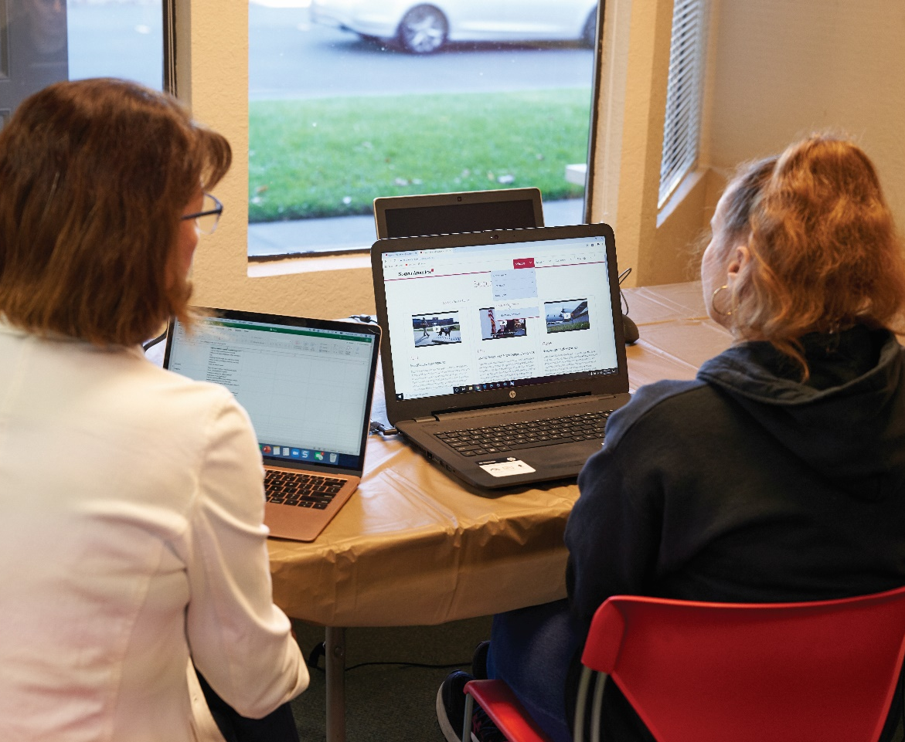
Example: User Experience Testing

Slide 13
The “Future of Work” Requires…
An accelerated need for
Asking the right questions, of the right people
Accessible and usable technologies
New ways to “show up” for work
The augmentation of human abilities
Recognize and respond to trends, do not become a consequence of the outcomes.

Slide 14
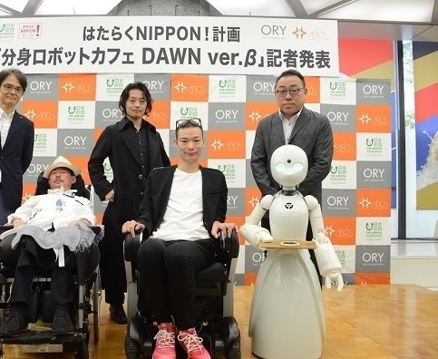
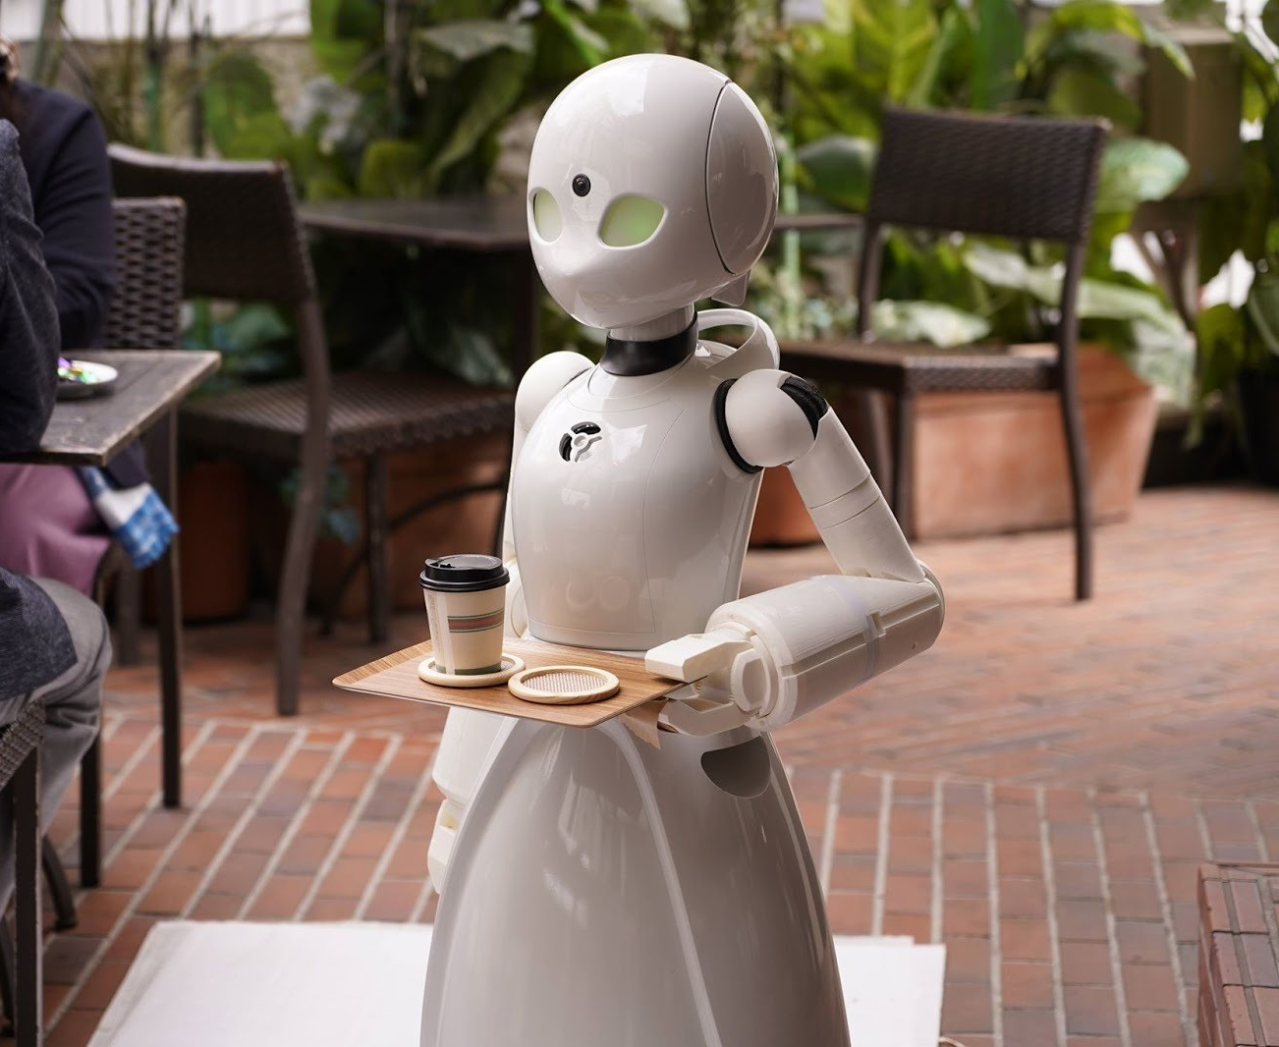
Example: Dawn Ver Café - Tokyo

Slide 15
Opportunity in Adversity
What can we do in response to the pandemic?
Break the cycle
Refuse to regress
Recognize that similarities overcome perceived differences
Amplify the benefits of an inclusive recovery
We have a shared responsibility to create the future we expect.

Slide 16
Questions, Comments, or Feedback?
Contact the Disabilities Issues Office
Call: 204-945-7613
Toll Free: 1-800-282-8069 (Ext. 7613)
dio@gov.mb.ca
AccessibilityMB.ca

Slide 17
Disabilities Issues Office
December 3, 2020
Presenting the
Manitoba Accessibility Awards
on the International Day of Persons with Disabilities
AccessibilityMB.ca

Slide 18
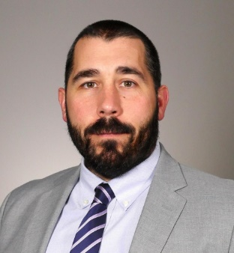
Thank You for Attending!
Stay-tuned for the DEAM webinar video & transcript at
AccessibilityMB.ca

