Slide 1
Measuring Citizen Satisfaction – Moving from Research to Results June 1, 2016 Winnipeg, MB
Institute for Citizen-Centred Service

Slide 2
Overview
Why Accessibility matters
Good Research Drives Results – A Canadian success story
Asking the right questions
The link between service and “trust and confidence”
Understanding “effort”
Leadership is responsible for “service culture”
Why accessibility is good for bottom-line

Slide 3
Citizens First 5

Slide 4
Citizens First 5

Slide 5
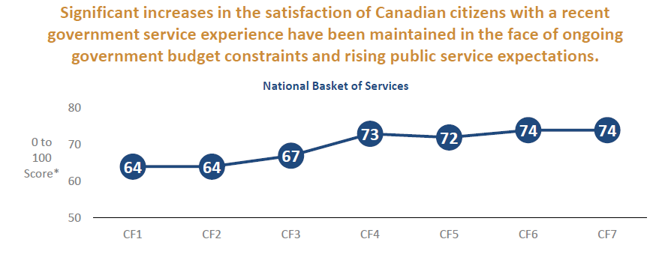
Customer Satisfaction Index Scores 1998-2014
Success Story?

Slide 6
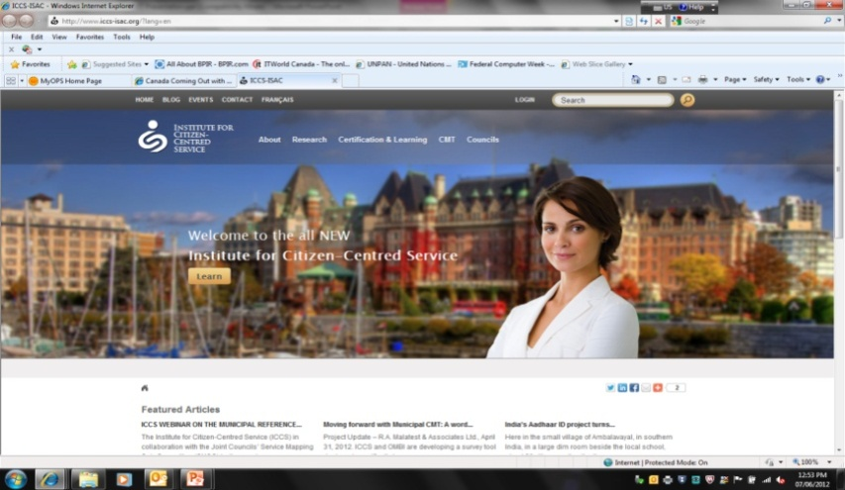
The Institute for Citizen-Centred Service
The mission of the ICCS is to support public-sector organizations in achieving high levels of citizen and business satisfaction with public services
The ICCS , supported by governments across Canada, promotes and supports improved service delivery by listening to and acting on the voice of the citizen.
Key activities:
Facilitating Inter-Jurisdictional Collaboration by providing secretariat services to two National Councils
Managing inter-governmental research agenda (Citizens First and Taking Care of Business)
Supporting and developing the Common Measurements Tool (CMT)
Managing ICCS Service Certification and Learning Program
Notes:
In 2001 the PSSDC established the Institute for Citizen-Centred Service to support its work. And when the ICCS was incorporated in 2005 it was joined by the PSCIOC as a co-sponsor
The ICCS acts as an independent and neutral platform for cross-jurisdictional collaboration across the country, it facilitates of joint research and innovative practices, it incubates new service delivery initiatives, and captures and disseminates of knowledge
Its key activities include…
Secretariat services for the PSSDC and PSCIOC
A research program, notably the branded CF and TCOB studies
The CMT and its benchmarking service
The Certified Service Manager training program
6

Slide 7
Asking the right questions
What are citizen expectations?
What was the actual experience?
What are the barriers?
What are drivers of satisfaction?
What are opportunities for improvement?
How can I help managers act?
Did we make a difference?
What are Citizen Expectations.......

Slide 8
Service Expectations For Routine Transactions

Slide 9
These five drivers explain 87% of citizen satisfaction with government services in Canada
N
Asking the Right Questions
Drivers of Satisfaction
Citizens First 5
CLIENT SATISFACTION
Previous
Experience
Timeliness
Ease of Access
Staff
Outcome
Notes:
Understanding what drives client satisfaction allows service leaders and managers to focus on the key levers to improve service quality and citizen satisfaction
Key drivers are identified by the strength of their impact on satisfaction
Service improvement priorities can, in turn, be identified by matching this impact or “importance” against organizational performance in these areas – (the ICCS uses a Priority Matrix to do this in its reports)
Focusing on an area of poor performance alone may be a mistake if it does not have a significant impact on satisfaction
Timeliness and Staff (the two drivers shown as stars on this slide) matter most because they have the biggest impact on satisfaction. They also show the greatest room for improvement across Canadian jurisdictions
The “Staff” driver encompasses a number of components that were previously reported as separate drivers in CF including:
Courtesy
Going the “Extra Mile”
Knowledge & Competence, and
Fairness

Slide 10
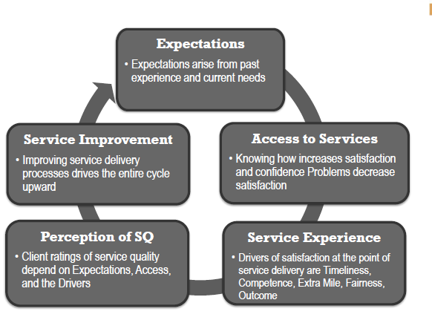
ICCS Service Improvement Framework

Slide 11
Asking the right questions
Benchmarking progress against yourself and and others
Common consistent measurement
 | Average Score (0-100)
 | National | Manitoba | Best in Class 1
Service Type | CF6 | CF6 | CF6
ALL PROVINCIAL/TERRITORIAL SERVICES | 71 | 71 | 76
Transactional | 76 | 78 | 81
Information/advisory services | 62 | 64 | 67
Relational | 70 | 67 | 76
Voluntary | 69 | 67 | 74
Involuntary | 76 | 79 | 83
Government delivered | 72 | 74 | 77
Third-party delivered | 67 | 62 | 72
Social Entitlement | 57 | 58 | 66

Slide 12
The Public Sector Service Value Chain
Engaged
Employees
Citizen
Service
Satisfaction
Citizen
trust &
confidence
A strong twin relationship exists between the two “links” above. Organizations with above average customer satisfaction also have above average employee satisfaction and vice versa.
“The link between employee satisfaction and client satisfaction is so strong that it has been called the satisfaction mirror in management literature.”
Heintzman and Marson 2005

Slide 13
Strong services contribute to trust and confidence in the public service
N
Drivers of Trust and Confidence in the Public Service
Citizens First 4
TRUST AND CONFIDENCE IN THE PUBLIC SERVICE
Strong services
Benefits to citizens
Strong leadership & management
Equal & ethical treatment
Notes:
Similar to Citizens First 3, the current study indicates that strong services make significant and positive contributions to confidence in the public service. This applies to services at all levels of government.
Other factors are also important. Citizens have more confidence in the public service when they believe they are treated fairly, equally and honestly; when they feel their leaders demonstrate competency and transparency; and when they see services having a positive effect on themselves and their community. Strong leadership and management have the greatest impact as shown with the star symbol. If citizens believe the public service has strong and competent leaders, they tend to have more confidence in it.
The relative importance of each driver varies by level of government, namely:
having strong, ethical leaders and managers is somewhat more important at the level of federal services; and
strong beliefs about the services and their benefits for individuals and communities are slightly more important for confidence in municipal and provincial/territorial levels of the public service.
These differences are not surprising given the public’s more immediate and proximate relationship with services at lower levels of government and the frequency with which citizens use services at these levels of government.

Slide 14
Why Customer Experience Matters?
CX Strategies Summit, April 7, Toronto

Slide 15
Hertz Vs Competitor
CX Strategies Summit, April 7, Toronto

Slide 16
Disability and Access Issues
Canadians with a disability reported having an average of 4 access problems receiving a service versus 3 for non-disabled Canadians (CF 5)

Slide 17
Service Experience – Manitoba (CF7 )

Slide 18
Manitoba vs. P/T Average (CF7)

Slide 19
Manitoba vs. P/T Average

Slide 20
Citizen-Centred Service and Service Management
“Citizen-Centred Service incorporates citizens’ concerns at every stage of the service design and delivery process; that is, citizens’ needs become the organizing principle around which the public interest is determined and service delivery is planned.”
Deputy Ministers’ Task Force
on Service Delivery Models (1996)

Slide 21
Service Management
Outside-in focus – Understanding client needs, expectations and experience.
Delivery is based on process capability
Service as science - Understand how service delivery is designed, measured and managed.
Competency based management of Human Resources – Expectations clear and support provided
Leaders are accountable for Service Culture

Slide 22
The Key Characteristics of Effective Public Sector Service Management:
What are the competencies and enablers of service management success?

Slide 23
Service managers need to be…
Shameless collaborators
Proactive problem-solvers
Citizen feedback liaisons
Improvers of processes
Builders of service culture

Slide 24
Evolution of Thinking about Customer Experience
Measurement
Of Expectations and Experience
Drivers of Satisfaction
Voice of Customer
Customer Experience (CX)
Design Thinking
“Nudge”

Slide 25
Thoughts
Good research can drive action and results.
Service management is two parts science and one part art
Better public sector service delivery management will improve accessibility for Canadians with disabilities
Opportunity for DI community to leverage existing research and funding (visibility and awareness)
System wide transformation requires collaboration and community – No jurisdiction is an island onto themselves.

Slide 26
Raising Your Game

