Slide 1
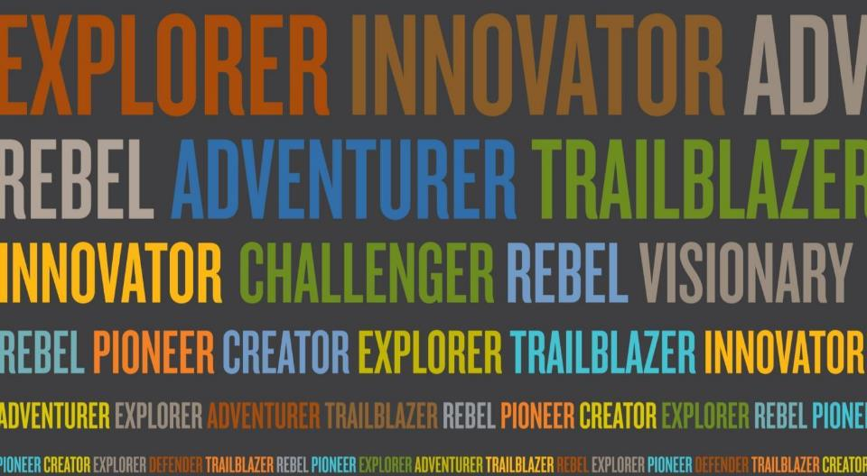
Lessons Learned: Introducing an Accessibility Plan to a Large Institution
Jackie Gruber
Human Rights & Conflict Management Officer
University of Manitoba
Jackie.Gruber@umanitoba.ca
^{Title of presentation}
^{umanitoba.ca}
Notes:
Intro
Ques. at the end
Quick little quiz to start off

Slide 2
Test your Knowledge
How many students attend the University of Manitoba:
a) 20,000
b) 25,000
c) 30,000
d) 35,000

Slide 3
c) 30,000

Slide 4
Test your Knowledge cont.
Of the 30,000 students at the University, what percentage of students have an ‘invisible disability’ registered with Student Accessible Services?

Slide 5
72% of students were reported to have ‘invisible disabilities’ in 2011
Notes:
72% in 2011

Slide 6
The 13 Identified Invisible Disabilities at the University of Manitoba in 2011
Notes:
Pie chart Diagram: (This diagram is showing the breakdown of invisible disabilities on campus, with Mental health being the largest population at 22.5%, and the ADHD and medical/ chronic illness behind it with roughly 17% of students in each category) Some of the ones most commonly associated with invisible disabilities like blind/visual and deaf/ hard of hearing are in the lower percentiles around 3.5% each.
Mental Health 22.5%
ADHD 16.9%
Medical/Chronic Illness 16.8%
Learning Disability 10.7%
Exam Anxiety 9.2%
Temporary 7.5%
Deaf/ Hard of Hearing 3.6%
Blind/Visual 3.4%
Asperger’s Syndrome 2.0%
Brain Injury 2.0%
Other 1.0%

Slide 7
Test your Knowledge cont.
How many faculty and staff work on campus:
a) 6,000
b) 11,000
c) 16,000
d) 21,000

Slide 8
Test your Knowledge cont.
b) 11,000
Notes:
Faculty staff: 6295
Support staff: 4553
Total 10848
Stats are from our office of institutional analysis

Slide 9
The Accessibility for Manitobans Act became law on December 5, 2013.
Legislation applies to all organizations that provide goods and services
Identify, prevent, and remove barriers to participation
Accessibility Plans due in 2016
Commitment to make Manitoba inclusive for everyone by 2023
Notes:
This is what we’re committed to and today I’m going to talk about what the U of M did

Slide 10
Customer Service Regulation
Student Accommodation
Employee Training
Educational Materials
Accessibility Information
Services on Campus
Compliance by Nov.1, 2017
Notes:
The majority of our customers are our students

Slide 11
What we are doing… our plan of action
Respond to AMA
Develop Committees
Accessibility at the U of M Survey
Barriers Audit Worksheet and Workshops
Define plan for barrier removal and future prevention strategy
Community Consultation and feedback
Create Accessibility Plan
Continue on to the next AMA standard
Notes:
On the slide there are 8 arrows and each arrow contains steps that we have done, are doing and will do

Slide 12
What we are doing… our plan of action
Respond to AMA
Develop Committees
Accessibility at the U of M Survey
Barriers Audit Worksheet and Workshops
Define plan for barrier removal and future prevention strategy
Community Consultation and feedback
Create Accessibility Plan
Continue on to the next AMA standard
This is where we are at now!
Notes:
This slide depicts where we are in the line of arrows we are half way!

Slide 13
Respond to Accessibility for Manitobans Act
Respond to AMA
Develop Committees
Accessibility at the U of M Survey
Barriers Audit Worksheet and Workshops
Define plan for barrier removal and future prevention strategy
Community Consultation and feedback
Create Accessibility Plan
Continue on to the next AMA standard
Notes:
Arrow #1 Respond to the AMA

Slide 14
ACCESSIBILITY FOR MANITOBANS ACT
University of Manitoba’s Accessibility Plan
Customer Service
Employment
Information & Communication
Transportation
Built Environment
Notes:
This slide contains the diagram we designed to explain the AMA, the Accessibility Plan and the Standards.
I found when I was doing presentations and trying to explain it to people that there was some confusion due to the differing deadlines so this is what I envisioned in my head which I would draw out to people and it seemed helpful.

Slide 15
Mission Statement
The University of Manitoba promotes diversity, inclusion, and accessibility in our programs, employment opportunities, and in the conduct of the University’s aﬀairs. We believe in the inherent dignity of all people. We are committed to identifying and removing the barriers that prevent full and meaningful participation in all aspects of campus life. The University will comply with all applicable Federal, Provincial, and Municipal legislation with respect to accessibility and will implement the standards speciﬁed under The Accessibility for Manitobans Act (“AMA”).

Slide 16
Develop Committees
Develop Committees
Respond to AMA
Accessibility at the U of M Survey
Barriers Audit Worksheet and Workshops
Define plan for barrier removal and future prevention strategy
Community Consultation and feedback
Create Accessibility Plan
Continue on to the next AMA standard
Notes:
Arrow #2 Develop Committees

Slide 17
Develop Committees
Committees:
AMA Steering Committee
Sub-Committees:
  Accessibility Planning
  Customer Service Training
  Information and Communication
  PSI Working Group
Develop Committees
Respond to AMA
Barriers Survey for Student, Staff, and Faculty Members
Develop and Deliver Worksheet Audit for DDD and provide Workshop
Define plan for barrier removal and future prevention strategy
Community Consultation and feedback
Create Accessibility Plan
Continue on to the next AMA standard

Slide 18
STEERING
COMMITTEE
Accessibility Planning
Postsecondary
Institution
Working Group
University Level
Unit Level
Employment
Transportation
Built Environment
Customer Service
Information &
Communication
Notes:
This slide shows a diagram of different committees and sub-committees that we have put together.
Steering committee is at the top of the tree diagram
The bubble then branches off in three directions, the first showing the accessibility planning
the second showing all the Customer Service and Information and Communication , subcommittees
and the third showing the postsecondary institution working group.

Slide 19
Steering Committee Members
Human Rights and Conflict Management Officer
Associate Vice-President of Human Resources
Vice-Provost of Academic Affairs
Director of Recreation Services
Legal Counsel
Director of Administration/Operations
Coordinator from Student Accessibility Services
Office Assistant from Disability Studies
… This is who and why
Notes:
Terms of reference written
Importance to involve student union and student groups

Slide 20
CIO, IST Enterprise Systems
Director of Ancillary Services
University Librarian
Director/Associate Professor from Disability Studies
Associate Director from Centre for the Advancement of Teaching and Learning
Vice-President, Advocacy, University of Manitoba Students’ Union
Students Living With Disabilities Representative

Slide 21
Accessibility Plan Subcommittee Members
Human Rights and Conflict Management Officer
Legal Counsel
Coordinator from Student Accessibility Services
Faculty Specialist-Education Innovation
Director/Associate Professor from Disability Studies
Office Assistant from Disability Studies
Liaison Librarian
Diversity Consultant
… This is who and why

Slide 22
Information and Communication Subcommittee Members
Human Rights and Conflict Management Officer
ITPC Manager
Client Relations Coordinator
Design and Production Manager
Purchasing Services Manager
Director Info Security & Compliance
Director of IST Client Services
Office Assistant from Disability Studies
… This is who and why

Slide 23
Information Technologist from Centre for the Advancement of Teaching and Learning
User Experience Librarian
Legal Counsel
Assistive Technologist
Director of Marketing & Communications
IT Technical Lead

Slide 24
Customer Service
Human Rights and Conflict Management Officer
Director of Administration/Operations
Assistant Director of Ancillary Services
Associate Director from Centre for the Advancement of Teaching and Learning
Director of Learning and Organizational Development
Liaison Librarian
Office of Student Life Director
… This is who and why

Slide 25
According to Prosci 2014 research results, based on a survey of over 800 organizations involved in implementing change, the Top Five Contributors to Success in an Organizational Change are (in order)
Visible executive sponsorship
Using a structured approach
Dedicating resources and funding to support the change process
Frequent and open communication about the change
Employee engagement and participation
Creasey, T. & Taylor, T. (2014). Best practices in change management (p. 14). [Loveland, CO]: Prosci.
Notes:
Engagement with Change Management
This flows so well number 1 is about sponsorship and the next slide discusses sponsorship
Footnote
Creasey, T. & Taylor, T. (2014). Best practices in change management (p. 14). [Loveland, CO]: Prosci.

Slide 26
Sponsorship
Goal to raise awareness and comply with legislative requirements
Survey – University Level
Accessibility Audit - Unit Level
Visionary Conversation
Accessibility Award
Notes:
Legislative requirements of the accessibility plan – consultation requirement and also with customer service training requirement

Slide 27
According to Prosci 2014 research results, when asked what they would do differently to improve, the organizations surveyed said (in order)
Involve leadership earlier in the project
Identify and secure resources earlier
Put more emphasis on the preparation and planning phase
Creasey, T. & Taylor, T. (2014). Best practices in change management (p. 24). [Loveland, CO]: Prosci.
Notes:
Footnote
Creasey, T. & Taylor, T. (2014). Best practices in change management (p. 24). [Loveland, CO]: Prosci.

Slide 28
STEERING
COMMITTEE
Accessibility Planning
Postsecondary
Institution
Working Group
University Level
Unit Level
Employment
Transportation
Built Environment
Customer Service
Information &
Communication
Notes:
This slide shows a diagram of different committees and sub-committees that we have put together.
Steering committee is at the top of the tree diagram
The bubble then branches off in three directions, the first showing the accessibility planning
the second showing all the Customer Service and Information and Communication , subcommittees
and the third showing the postsecondary institution working group.

Slide 29
PSI Working Group
University of Winnipeg
Brandon University
University College of the North
Red River College
Canadian Mennonite University
Manitoba Institute of Trades and Technology
St. Boniface University
University of Manitoba
Assiniboine Community College
Notes:
COU
Draft terms of reference
Revolving chairs, different hosts

Slide 30
Accessibility Videos
https://www.youtube.com/watch?v=G8CgXKLoHT0
https://www.youtube.com/watch?v=eiyawDIj1NY

Slide 31
According to Prosci 2014 research results, when asked what advice they would give to other organizations implementing a change, those surveyed recommended (in order):
Communicate early and target communication to your audience(s)
Spend more time on stakeholder analysis so that you understand employee’s capacity to adopt a change
Invest in relationship and coalition building
Creasey, T. & Taylor, T. (2014). Best practices in change management (p. 30). [Loveland, CO]: Prosci.
Notes:
Footnote:
Creasey, T. & Taylor, T. (2014). Best practices in change management (p. 30). [Loveland, CO]: Prosci

Slide 32
Consulting with Our Community Survey
Accessibility at the U of M Survey
Respond to AMA
Develop Committees
Barriers Audit Worksheet and Workshops
Define plan for barrier removal and future prevention strategy
Community Consultation and feedback
Create Accessibility Plan
Continue on to the next AMA standard
Notes:
Arrow #3 Accessibility at the U of M Survey

Slide 33
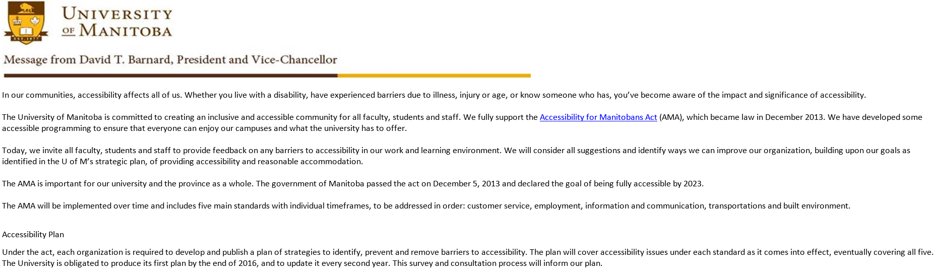
Consulting with Our Community Survey
Notes:
Screenshot of survey and discuss process

Slide 34
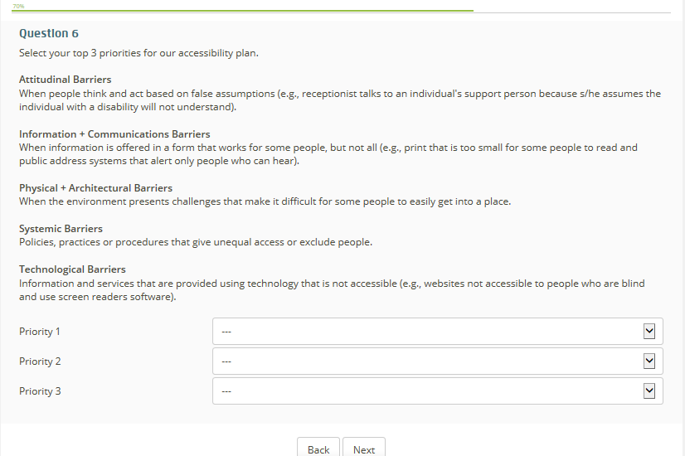
Consulting with Our Community Survey
Notes:
Screenshot of survey

Slide 35
Worksheets and Workshops
Barriers Audit Worksheet and Workshops
Respond to AMA
Develop Committees
Accessibility at the U of M Survey
Define plan for barrier removal and future prevention strategy
Community Consultation and feedback
Create Accessibility Plan
Continue on to the next AMA standard
Notes:
Arrow #4 Barrier Audit Worksheet and Workshops

Slide 36
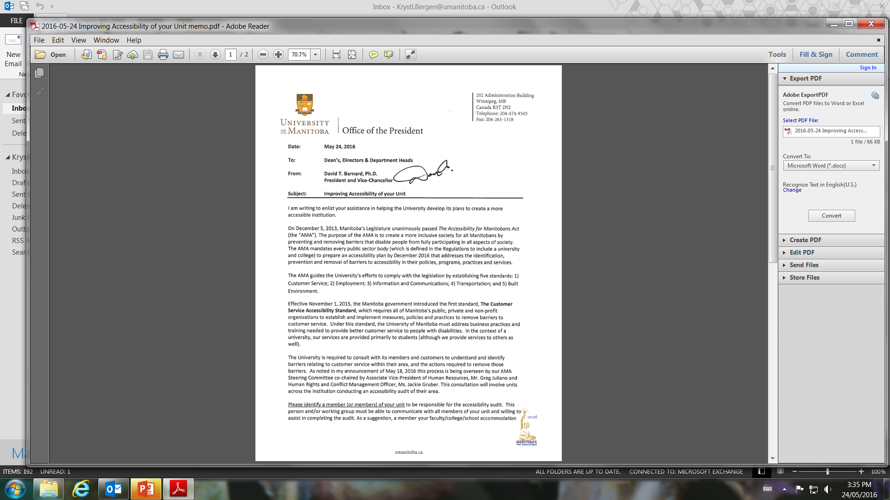
Worksheets and Workshops
Notes:
Screen shot of President Barnard’s memo

Slide 37
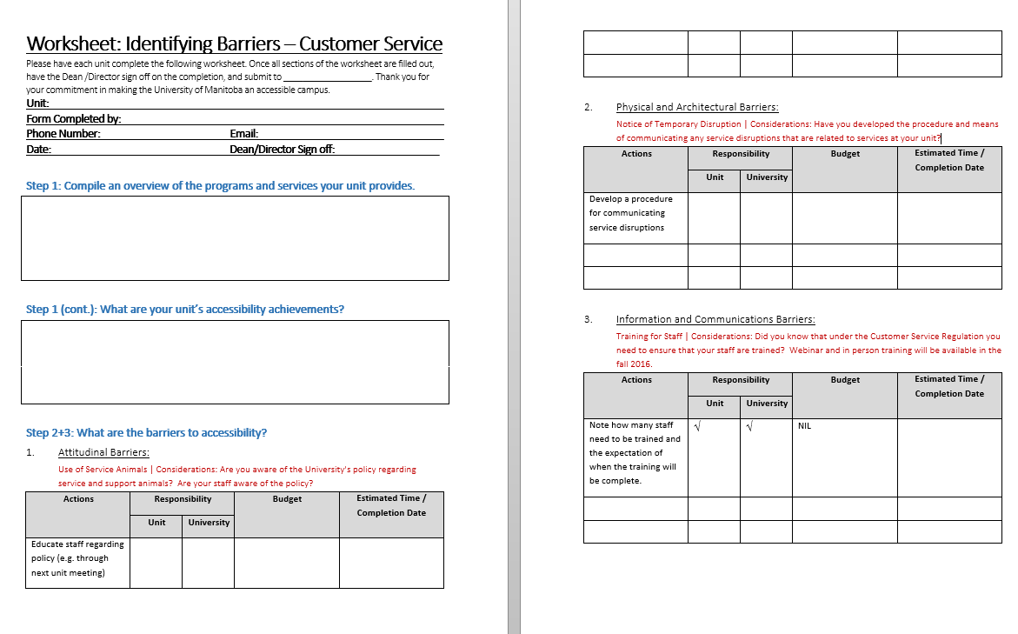
Worksheets and Workshops
Notes:
Screen shot of the worksheets

Slide 38
Barrier Removal and Prevention Strategy
Define plan for barrier removal and future prevention strategy
Respond to AMA
Develop Committees
Accessibility at the U of M Survey
Barriers Audit Worksheet and Workshop
Community Consultation and feedback
Create Accessibility Plan
Continue on to the next AMA standard
Notes:
Arrow #5 Define plan for barrier removal and future prevention strategy
This stage is important and we are not here yet. This will come after we have gathered all our data and information for the surveys and the audits. We will combine the results to identify where these barriers exist and from here we will develop an action plan to remove these barriers and also create a strategy that is campus wide for preventing these barriers in the future.

Slide 39
Community Consultation and Feedback
Community Consultation and feedback
Respond to AMA
Develop Committees
Accessibility at the U of M Survey
Barriers Audit Worksheet and Workshop
Define plan for barrier removal and future prevention strategy
Create Accessibility Plan
Continue on to the next AMA standard
Notes:
Arrow #6 Community Consultation and feedback

Slide 40
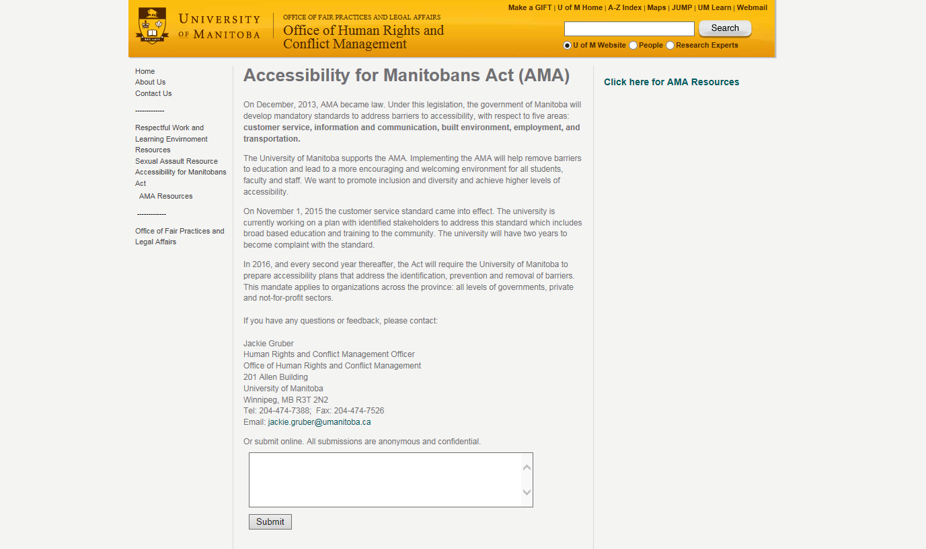
http://umanitoba.ca/human_rights/ama_fb.html
Notes:
Screenshot of the AMA website at the U of M

Slide 41
http://umanitoba.ca/human_rights/ama_fb.html
a feedback feature
Notes:
Screenshot of the AMA website at the U of M with feedback feature
Working on an accessibility hub over the summer

Slide 42
Creating an Accessibility Plan
Create Accessibility Plan
Respond to AMA
Develop Committees
Accessibility at the U of M Survey
Barriers Audit Worksheet and Workshop
Define plan for barrier removal and future prevention strategy
Community Consultation and feedback
Continue on to the next AMA standard
Notes:
Arrow #7 Create Accessibility Plan

Slide 43
Create Accessibility Plan Draft for Review
Gather Consultation Feedback
Update Plan based on feedback
Edits
Send Accessibility Plan to Steering Committee for input
Send Accessibility Plan to MCO for review
Finalize
Deliver Accessibility Plan to Gov.
Promote + Post plan on the website
Notes:
On slide reviews the steps we will be going through to create an accessibility plan

Slide 44
The next steps… Moving onto the next AMA standard
Continue on to the next AMA standard
Respond to AMA
Develop Committees
Accessibility at the U of M Survey
Barriers Audit Worksheet and Workshop
Define plan for barrier removal and future prevention strategy
Community Consultation and feedback
Create Accessibility Plan
Notes:
Arrow #8 Continue on to the next AMA slide

Slide 45
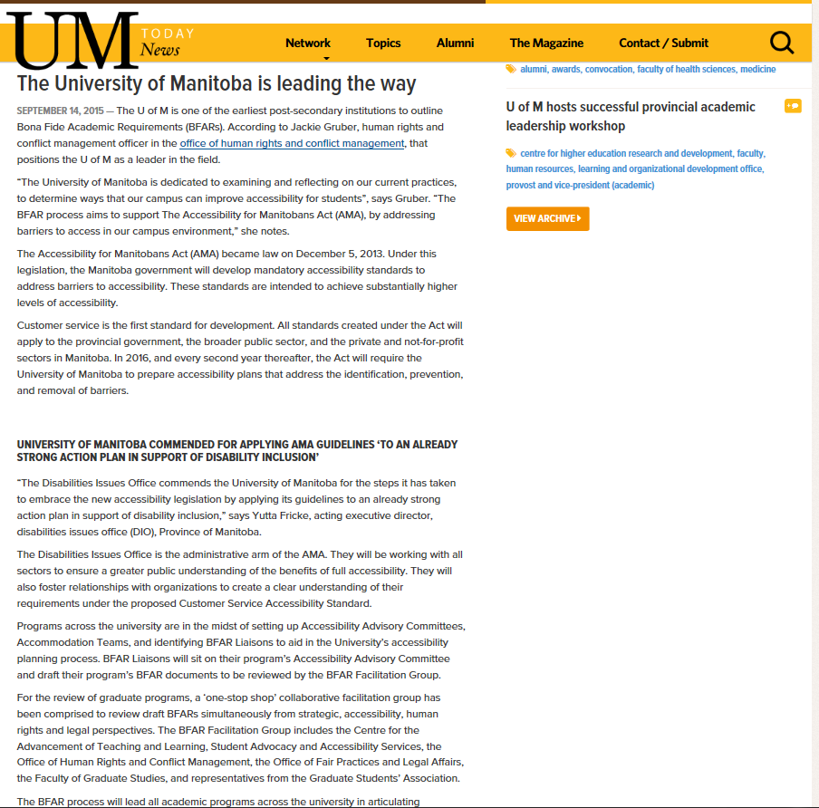
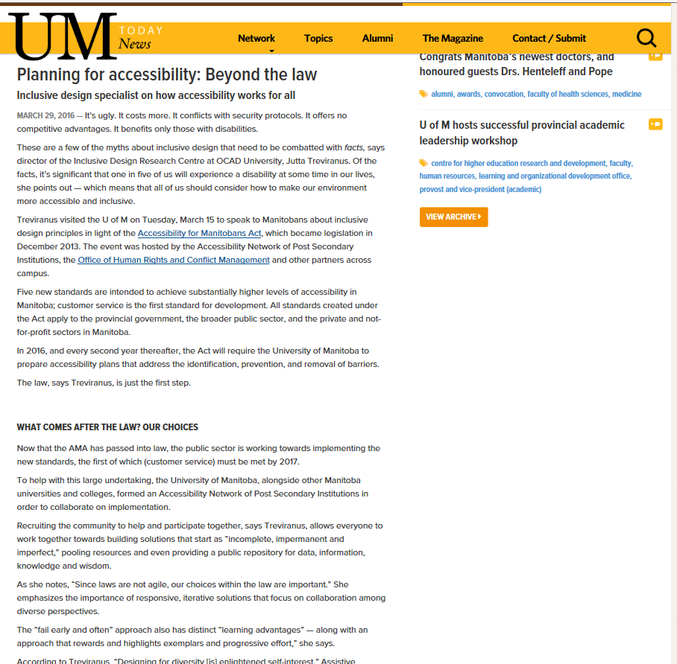
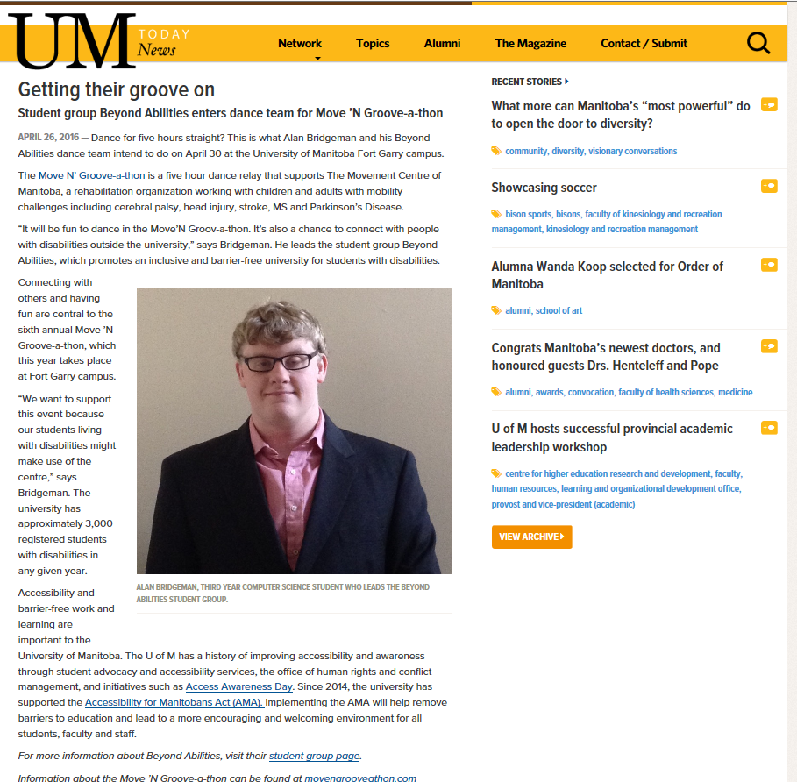
Raising Awareness
UM Articles:
1. http://news.umanitoba.ca/the-university-of-manitoba-is-leading-the-way/?utm_source=umtoday&utm_medium=email
2. http://news.umanitoba.ca/planning-for-accessibility-beyond-the-law/
3. http://news.umanitoba.ca/getting-their-groove-on/
Notes:
On slide screenshot of articles

Slide 46
Lessons Learned:
Approach Senior Executive early on in the process
This needs an endorsement from the “top” in terms of priorities and sponsorship
Develop a communication strategy and include change management early on
Hire a graduate student
Think Strategic Planning
Multi-prong approach of influence
Committee attendance
To be continued……
Celebrate achievements!!!!

Slide 47
Thank you for your time.
Questions + Comments?

Slide 48
^{Title of presentation}
^{umanitoba.ca}

