Slide 2
Land Acknowledgement
Aaniin, Boozhoo, Tansi, Wotziye, Ho/Han, Tanshi, Tunngasugitsi!
The IDPD 2021 Webinar is located on Treaty 1 Territory,
the original lands of the Anishinaabeg, Cree, Oji-Cree, Dakota,
& Dene peoples, and the homeland of the Métis Nation.
We encourage you to reflect on the history of the land
that you are watching from.
https://www.whose.land/en/

Slide 3
Webinar Housekeeping
Tech Issues?
Call: 204-945-7613
Manitoba Accessibility Office
Questions for our presenters & panelists?
Type them in the chat box.
MAO@gov.mb.ca

Slide 4
December 3rd International Day of Persons with Disabilities
Proclaimed in 1992 by the United Nations General Assembly¹.
Promotes the rights & well-being of people with disabilities in all spheres of society & development.
Increases awareness of the situations of people with disabilities in every aspect of political, social, economic & cultural life².
Adopted in 2006, the
Convention on the Rights of Persons with Disabilities (CRPD), has further advanced the rights & well-being of persons with disabilities³.
References: https://www.un.org/en/observances/day-of-persons-with-disabilities/background

Slide 5
IDPD 2021 Webinar Outline
Greetings and Opening Remarks from Honourable Rochelle Squires
Presentation from Karen Sharma, Manitoba Human Rights Commission
Presentation from Lucía Madariaga, Accessibility Compliance Secretariat
Panel Discussion among people who use service animals (Yvonne Peters, Vivi Dabee, & Bill Tucker)
Questions & Answers
Closing Remarks

Slide 6
Greetings & Opening Remarks
Honourable Rochelle Squires, Minister of Families and Minister responsible for Accessibility
Rochelle Squires was elected as the MLA for Riel in 2016 and 2019. She holds a Bachelor of Arts in communications from the University of Winnipeg, a Master of Fine Arts from the University of British Columbia and a Journalism Diploma from Red River College.
She and her husband Daniel have a combined family of five children and one grandson.

Slide 7
Presenters
Karen Sharma, A/Executive Director
Lucía Madariaga,
Assistant Director, Compliance Secretariat

Slide 8
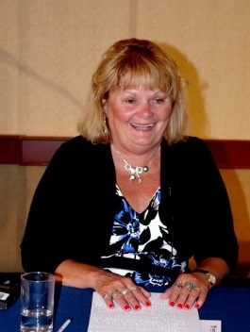
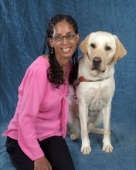
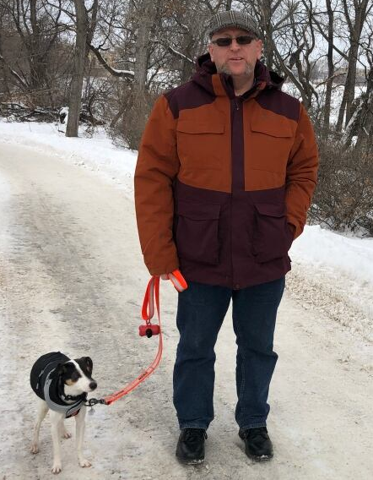
Panelists
Yvonne Peters
Vivi Dabee
Bill Tucker

Slide 9
Questions or Comments?
Contact the Manitoba Accessibility Office
Call: 204-945-7613
Toll Free: 1-800-282-8069 (Ext. 7613)
mao@gov.mb.ca
AccessibilityMB.ca

Slide 10
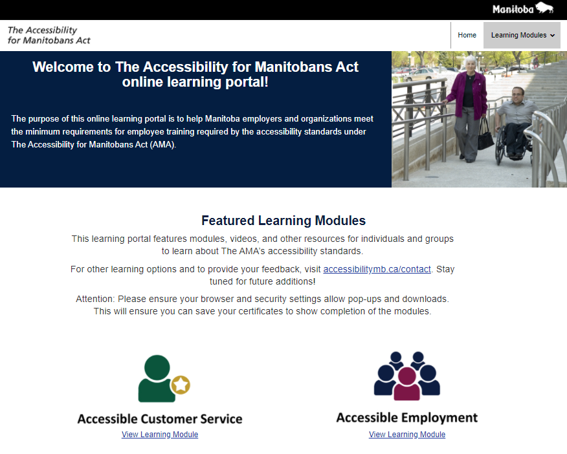
New Resources – Online Learning Portal
English AMALearningMB.ca
French lamformationmb.ca

Slide 11
Reminder: May 1, 2022 Compliance Deadline Accessibility Standard for Employment
New Resources:
Accessibility Standard for Employment FAQs
Accessibility Standard for Employment Barriers & Solutions
These new resources are included among a variety of learning tools, such as the:
Accessibility Standard for Employment Handbook
Accessibility Standard for Employment Policy Guide
Guide to Create an Individualized Accommodation Plan Process & Policy
Accessibility in the Workplace: Good for Everyone, Law in Manitoba Video

Slide 12
Building Sustainable Communities Program Application Deadline January 17, 2022
Helps build thriving, sustainable communities that provide a high quality of life for Manitobans
Leverages investments in community development by local governments, non-profit organizations & others
https://www.gov.mb.ca/grants/grant-name.html

Slide 13
Sincere thanks to our webinar presenters, panelists, & ASL interpreters!
Karen Sharma
Lucía Madariaga
Yvonne Peters
Vivi Dabee
Bill Tucker
ASL Interpreters

Slide 14
Thank you for joining us!
Wishing you safe & happy holidays!

