Slide 2
Land Acknowledgement
Boozhoo, Tansi, Aaniin, Wotziye, Ho/Han, Tanshi, Tuungasugitsi!
This International Day of Persons with Disabilities Celebration is located on Treaty 1 Territory, the original lands of the Anishinaabeg, Cree, Oji-Cree, Dakota, & Dene peoples, and the homeland of the Métis Nation.
We encourage you to reflect on the history of the land
that you are watching from.

Slide 3
Questions, Comments, Technical Assistance
Call: 204-945-7613
Toll-free: 1-800-282-8069 ext. 7613
Email: dio@gov.mb.ca

Slide 4
Webinar Program
Ministerial greeting & opening remarks
Update from the Disabilities Issues Office
Keynote speaker Yvonne Peters, human rights lawyer
Introduction of the Manitoba Accessibility Awards & winners
Closing Remarks

Slide 5
Minister’s Greeting & Opening Remarks
Families

Slide 6
As of December 2020, the Disabilities Issues Office is now the…

Slide 7
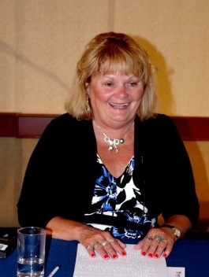
Keynote Speaker Yvonne Peters
Human rights lawyer for over 30 years
Served as legal counsel & advisor on a number of equality test cases involving disability rights & women’s rights
Continues her human rights work as a volunteer with a number of community organizations
True Accessibility Champion

Slide 8
About the Manitoba Accessibility Awards
To celebrate Manitoba organizations & businesses that have shown leadership & innovation in accessibility
Thank you to the Manitoba Accessibility Awards Selection Committee
Thank you to all nominators & nominees

Slide 9
Thank you to all Shortlisted Nominees
City of Selkirk
City of Winnipeg
Community Futures Heartland
E-Quality Communications Centre of Excellence
Gateway Church
Herman Prior
Provincial Exhibition of Manitoba
Pelican Yacht Club
Red Apple Store – Stonewall
RM of Victoria Beach
Southwest Community Options
Unit 204 Productions
Winnipeg Airports Authority
Woodlands Pioneer Museum
World Trade Centre – Winnipeg

Slide 10
Manitoba Accessibility Awards Categories
Business (large & small)
Non-profit organization (urban & rural)
Large & small municipality

Slide 11
Large Business

Slide 12
Large Business
Winnipeg Airports Authority

Slide 13
Small Business

Slide 14
Red Apple - Stonewall
Small Business

Slide 15
Non-Profit Organization - Urban

Slide 16
Non-Profit Organization - Urban
Gateway Church

Slide 17
Non-Profit Organization - Rural

Slide 18
Non-Profit Organization - Rural
Woodlands Pioneer Museum

Slide 19
Large Rural Municipality

Slide 20
Large Rural Municipality
City of Selkirk

Slide 21
Small Rural Municipality

Slide 22
Small Rural Municipality
RM of Victoria Beach

Slide 23
Congratulations Winners!

Slide 24
COVID-19 Resources & Previous Webinars
AccessibilityMB.ca

Slide 25
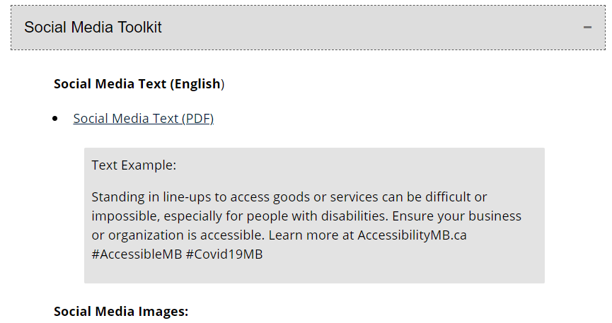
Accessibility During COVID-19
Featured Content:
Impact of COVID-19 on Manitobans with Disabilities
COVID-19 Resources
Social Media Toolkit
If your business or organization has at least one employee:
Offer accessible service during COVID-19
Keep Employees Safe

Slide 26
Thank you to all IDPD & MBAA Contributors!
Yvonne Peters
Red Apple – Stonewall
Winnipeg Airports Authority
Gateway Church
Woodlands Pioneer Museum
RM of Victoria Beach
City of Selkirk
ASL & Caption Services
MAO Staff
Erika Vas & Rocco Scarcella (webinar production)

Slide 27
Thank you for joining us!
Wishing you safe & happy holidays!

