Slide 1
Pilot Year 2022/2023 Overview for Applicants
Deadline: April 15, 2022

Slide 2
Background
In April 2021, the Manitoba government announced the creation of a $20 million endowment fund held by the Winnipeg Foundation to enhance Manitoba’s accessibility and to support compliance with The Accessibility for Manitobans Act (AMA) and its standards.
As of 2022/23, the Manitoba government will use the annual growth of the endowment fund to distribute grants to organizations and businesses via the Manitoba Accessibility Fund (MAF).
2022/23 is a the MAF Pilot Year. MAF objectives and target recipients may change from year to year.

Slide 3
AMA Accessibility Standards
In the Pilot Year, MAF will focus on the first three accessibility standards:
Customer service (2015) aims to prevent and remove barriers to accessing goods and services
Employment (2019) requires barrier-free practices related to employee recruitment, hiring and retention
3. Information and Communications (anticipated in 2022) which sets requirements for removing barriers to information and communications electronic, in print and in person information.

Slide 4
2022/23 Objectives
Projects must support Manitoba’s accessibility law by:
Raising awareness about the prevention and removal of
barriers,
Developing tools, resources and training to support
compliance with AMA standards, and/or
Removing barriers to information and communications.

Slide 5
Examples of eligible activities (1/3)
Objective 1: raising awareness about the prevention and removal of barriers
A construction company plans to hire employees with disabilities, including people who are Deaf and hard of hearing. It consults with employment agencies and disability organizations about accommodations in the sector, and does research about best practices. It will expand the project’s impact by sharing best practices with Manitoba’s construction sector.
5
Notes:
Another example: A Manitoba employment agency wishes to promote the Accessibility Standard for Employment by participating in as Disability Employment Awareness Month, which is celebrated annually in Manitoba. It plans to use a social media campaign to promote accessible hiring practices throughout the month, including a free webinar in which the agency offers tips on accessible hiring. It will collaborate with business associations to reach specific sectors, e.g. retail.

Slide 6
Examples of eligible activities (1/3)
Objective 1: raising awareness about the prevention and removal of barriers…continued
A summer day camp includes children with disabilities and wants to exceed requirements of the Accessibility Standard for Customer Service. It will start by consulting other inclusive camps to enhance its policies and programs, then will apply the model to its August day camps and evaluate the model. Findings will be shared with other Manitoba camps.
Projects that celebrate events including: Manitoba Access Awareness Week, Indigenous Disability Awareness Month, International Day of Persons with Disabilities, “#PurpleLightup” global awareness campaign of the economic contribution of people with disabilities.
6

Slide 7
Examples of eligible activities (2/3)
Objective 2: developing tools, resources and training to support compliance with AMA standards
A community club plans to design a training program on the Accessibility Standards for Customer Service or Employment with a focus on its services and participants. It will expand the project’s impact by collaborating with similar community organizations.
Provide staff training on how create accessible documents, for example using Microsoft Word. Training could be offered to staff on how to provide accessible in-person communication, including for people who are agitated or have difficulty understanding.
7

Slide 8
Examples of eligible activities (3/3)
Objective 3: removing barriers to information and communications
A small municipality wishes to review its information and communication to determine best practices to be inclusive of their diverse community members. It plans to consult with community members, disability organizations and experts on web accessibility before updating its website. It will produce a project report to share with other small municipalities.
Producing key information using video-taped American Sign Language.
8

Slide 9
Examples of eligible activities (3/3)
Objective 3: removing barriers to information and communications… continued
Creating a best practice guide for educators meeting students online, including speaking tips for diverse audiences, using technology of various platforms, applying closed captioning to images, and other accommodations.
Hiring a consultant to improve accessibility of a website (digital enhancements must be consistent with WCAG 2.1 Level AA).
Adding a large screen monitor to help clients access services, e.g. for employment seekers with low vision to access online employment training
9

Slide 10
Ineligible activities
Projects outside of Manitoba
Retrofits and renovations affecting buildings, as specified in the Manitoba Building Code
On-going operational costs or programs
Core or essential services that are the responsibility of the municipal, provincial or federal body
Projects linked to the delivery of core education, health and social services programs delivered through provincial or federal funding
Private residential Wage subsidies, placement programs or employee assistance programs

Slide 11
Organizational Eligibility
Eligible - Businesses
- Non-profit organizations, including unions - Charitable organizations
- Municipalities, local authorities, planning districts
- Northern Affairs Community Councils
- School divisions, universities, and colleges
Ineligible - Individuals
- Organizations not located in Manitoba
- Organizations not open to the public (private clubs)

Slide 12
Funding
Maximum grant amount in 2022/23 is $50,000
No minimum amount
MAF will fund up to 100% of costs
Application may include up to 10% for administration
An organization is limited to one application per year, but may collaborate with multiple applicants.

Slide 13
Eligible & Ineligible Costs
Eligible - Salaries for project staff and consultants
- Project and resource promotion
- Translation into French, American Sign language and Manitoba’s indigenous languages
Ineligible - general operating costs
- building renovations (such as ramps, and automatic door openers)
- furniture, including to accommodate employees
See MAF Guidelines for complete list.

Slide 14
Selection
Eligibility: Applicant and project meet all eligibility criteria and have completed the application requirements by the deadline. The project supports the 2022/23 objectives.
Capacity: Does the applicant have the ability to administer, manage and oversee the project with the available human and financial resources? Does the applicant show a commitment to accessibility?
Work plan, budget and results: Does the project set out clear steps within a reasonable timeframe and budget? Does the project identify reasonable results and a means of evaluating these?

Slide 15
Selection
Inclusion: Has the applicant integrated the expertise of Manitobans disabled by barriers in the development, delivery and/or evaluation of the project? Will the project engage a significant number of people and/or organizations?
Impact: Will the proposed project enhance accessibility awareness and compliance with the AMA? Will the project benefit a significant number people or serve as a model for other organizations? Does the project target an underserved population or region?
Other considerations: Depending upon demand, priority will be given to projects that demonstrate innovation, respond to identified needs and promote accessibility beyond the funding period.

Slide 16
2022/23 Applications
Application intake begins March 1, 2022
Application deadline is April 15, 2022
Organizations may submit only one application, but may collaborate in multiple projects.

Slide 17
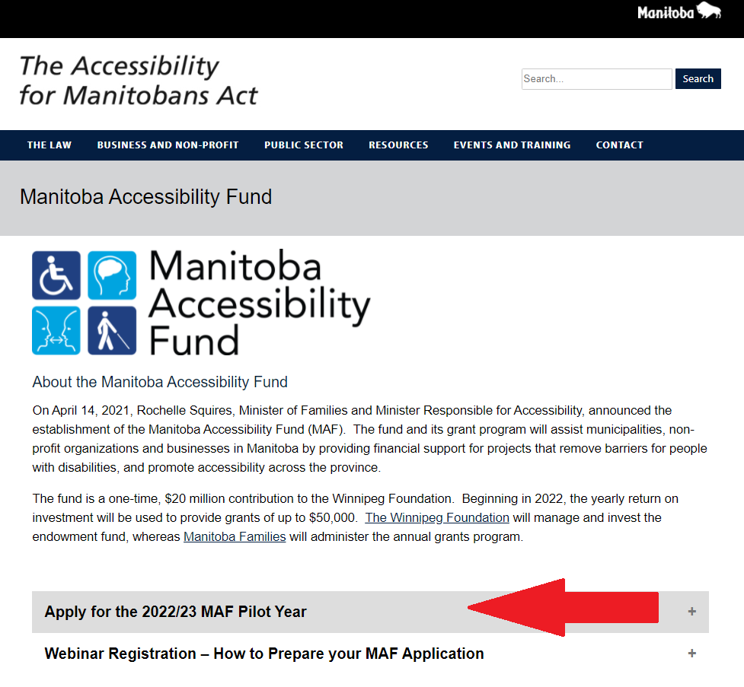
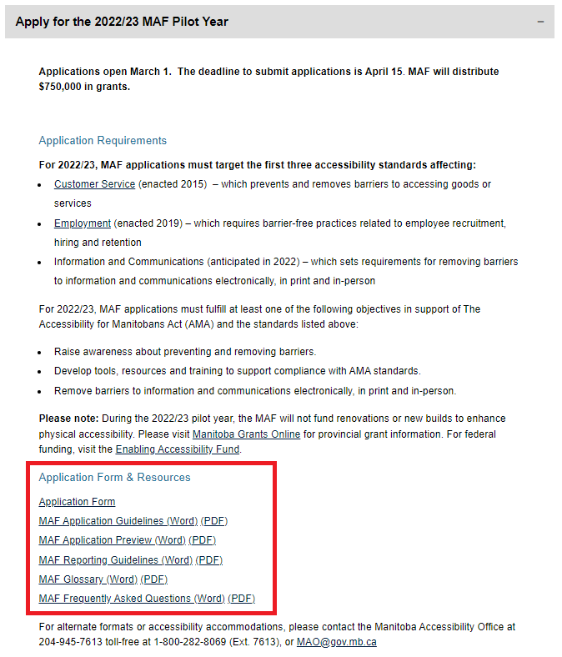
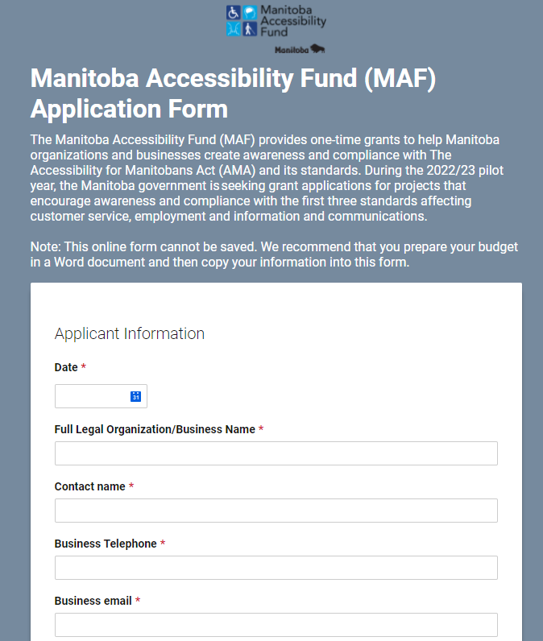
MAF Resources
AccessibilityMB.ca/fund.html

Slide 18
Applicant Information
Full legal organization/business name
Contact name
Organization/business telephone
Organization/business email
Organization/business website, if applicable
If your organization has been operating in Manitoba on or before March 1, 2021

Slide 19
Categories of Manitoba Applicants
Non-profits, including charities, unions and professional or other organizations that are registered with the Companies Office or smaller non-profits with a registered bank account and in operation for at least one year. MAF funds non-profits on reserve.
Municipalities and local authorities, including planning districts & Northern Affairs Community Councils
Businesses including franchises that are registered with the Companies Office. MAF funds businesses on reserve.
Public sector organizations, including universities, colleges, school divisions. Crown Corporations are ineligible.

Slide 20
Provide Charitable or Business Numbers
Registered Charity #
Business/Incorporation #
Unincorporated Non-Profit: Tell us about your unincorporated non-profit year it was formed, examples of main programs, and if it has a bank account.

Slide 21
Project Summary
Project Name
Select one or more of the three MAF objectives that the project will address
Provide a summary of your project (300 word maximum)
Describe how the project will address the objective(s) through activities, tools, resources and training, and/or enhanced information and communications.
Timeline
Provide the project’s start and end dates (projects must be completed before March 31, 2023)

Slide 22
Organizational Description
What is the mandate and purpose of your organization and its main activities? (Large organizations may wish to focus on the division or department initiating the project.)
Describe your previous experience addressing accessibility e.g. staff training to meet the AMA’s customer service and employment standards. See also AccessibilityMB.ca
Describe the skills of the project team
= selection criteria “capacity”

Slide 23
Project Description
Provide a detailed project work plan including key activities and timelines.
What are the expected results?
How will you evaluate and measure whether you have achieved the project objectives?
e.g. number of participants or distribution of new tools.
= selection criteria “work plan & results”

Slide 24
Project Inclusion
Describe how you will work with or engage Manitobans with disabilities and/or their organizations, noting the stage of the project: development (including this application), planning, delivery and/or as participants of an activity or event?
Describe the collaboration with other individuals, organizations or networks.
. = selection criteria “inclusion”

Slide 25
Project Impact
How will the project enhance awareness of accessibility and/or compliance with The Accessibility for Manitobans Act and its standards?
Who will benefit from this project and how? Who else could benefit indirectly, for instance, through shared knowledge, tools or innovations?
Does the project affect a particular demographic that faces additional barriers, for example based on Indigeneity, newcomer status, race, age or region of Manitoba?
. = selection criteria “impact”

Slide 26
Project Budget
Provide in dollars, the project grant request.
Use the budget template to list costs totalling the grant request. Matching funds are not required but may be added.
Use the budget template provided with the online application form.
= selection criteria “budget”

Slide 27
Timelines
The MAF pilot year is aligned as much as possible with Manitoba government’s fiscal year: April 1, 2022 to March 31, 2023.
The application deadline is April 15, 2022.
Applicants will be notified of approval or rejection within six (6) weeks of the deadline.
Projects must be completed by March 31, 2023.
Project reports must be submitted within 60 days of the project end.

Slide 28
Payment Process
90% of the approved funding will be provided upon signing of the project Contribution Agreement.
Final payment of 10% will be made upon receipt and acceptance of the final report and supporting documents by the Manitoba Accessibility Office.
Projects may be subject to audit by the Manitoba government.

Slide 29
Terms and Conditions
Following approval, a project Contribution Agreement must be signed between the applicant and the Manitoba government.
The agreement will layout:
- Acceptable use of funds
- Project start and end date
- Payment schedule
- Reporting requirements

Slide 30
Final Report
A final report is required within 60 days of project completion or by the deadline identified in the project contribution agreement.
The final report includes a narrative report and a final statement of revenue and expenses, as related to the project’s approved budget.
Provide a final statement of revenue and expenses as related to the project’s approved budget. The Manitoba government will issue the final 10% payment upon approval of the final report.
See MAF Reporting Guidelines online.

Slide 31
How To Apply
Submit a completed application form online.
If you require an alternate format, please notify the
Manitoba Accessibility Office
Email: MAF@gov.mb.ca
Phone: 204-945-7613 (in Winnipeg)
Toll Free: 1-800-282-8069, Ext. 7613 (outside Winnipeg)
Fax: 204-948-2896, or post:
Room 630 - 240 Graham Avenue
Winnipeg MB R3C 0J7

Slide 32
Next Steps
Download Adobe Reader.
Download MAF guidelines and application preview.
Consult with stakeholders in developing your project.
Collaborate to access expertise and expand the project impact.
Help us create a more accessible Manitoba
with your application for MAF 2022/23!
Deadline: April 15, 2022

Slide 33
Thank You!
If you have questions, please do not hesitate to contact the Manitoba Accessibility Office at:
Email: MAF@gov.mb.ca
Phone: 204-945-7613
Phone Toll-Free: 1-800-282-8069, Ext. 7613

